Slide 1


Welcome to Insight Community Session 01: Basic Statistics

Slide 2

General Rules:
• Keep yourselves on mute at all the times unless asked otherwise. For any queries, put it in the chat and it’ll be taken care of.
• Attendance for the session will be floated randomly during the session. There will be a QR code that you’ll need to scan and mark the attendance.
• There will be assignments that need to be submitted before deadline. They shouldn’t be copied.
• Regular attendance, regular & quality assignment submissions are an integral part of evaluation for the 2nd round of Insight hiring.
• You can reach out to anyone from the Insight team for any query.

Slide 3
I. Population vs Sample

Slide 4
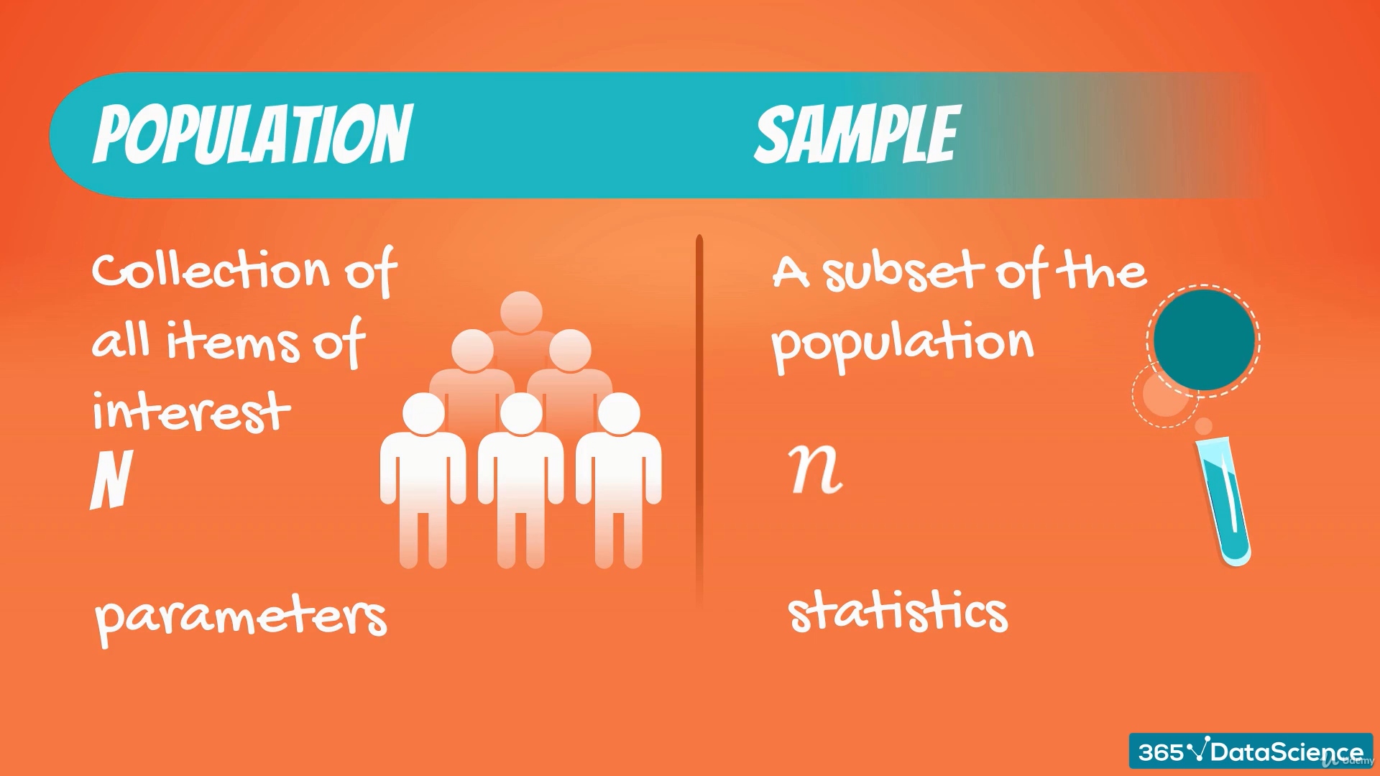


Slide 5
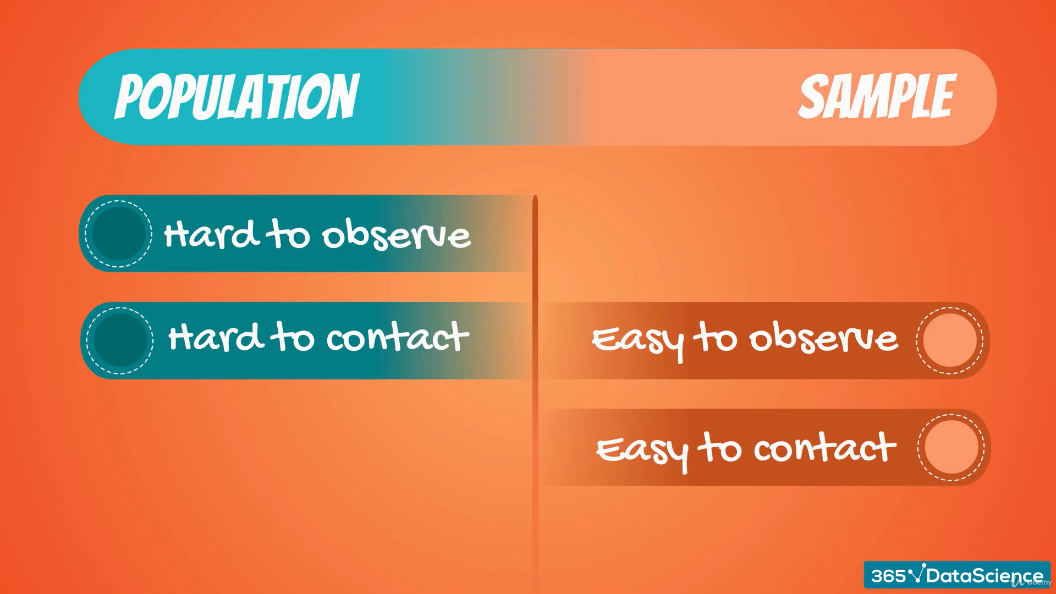

Slide 6
Features of a sample
Randomness | Representativeness
When each member of the sample is chosen from the population strictly by chance. | A subset of the population that accurately reflects the members of the entire population.

Slide 7
II. Type of Variables

Slide 8
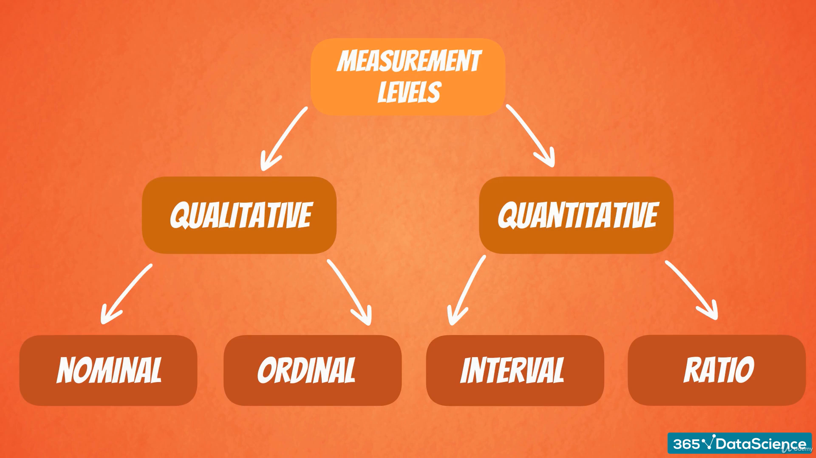

Slide 9
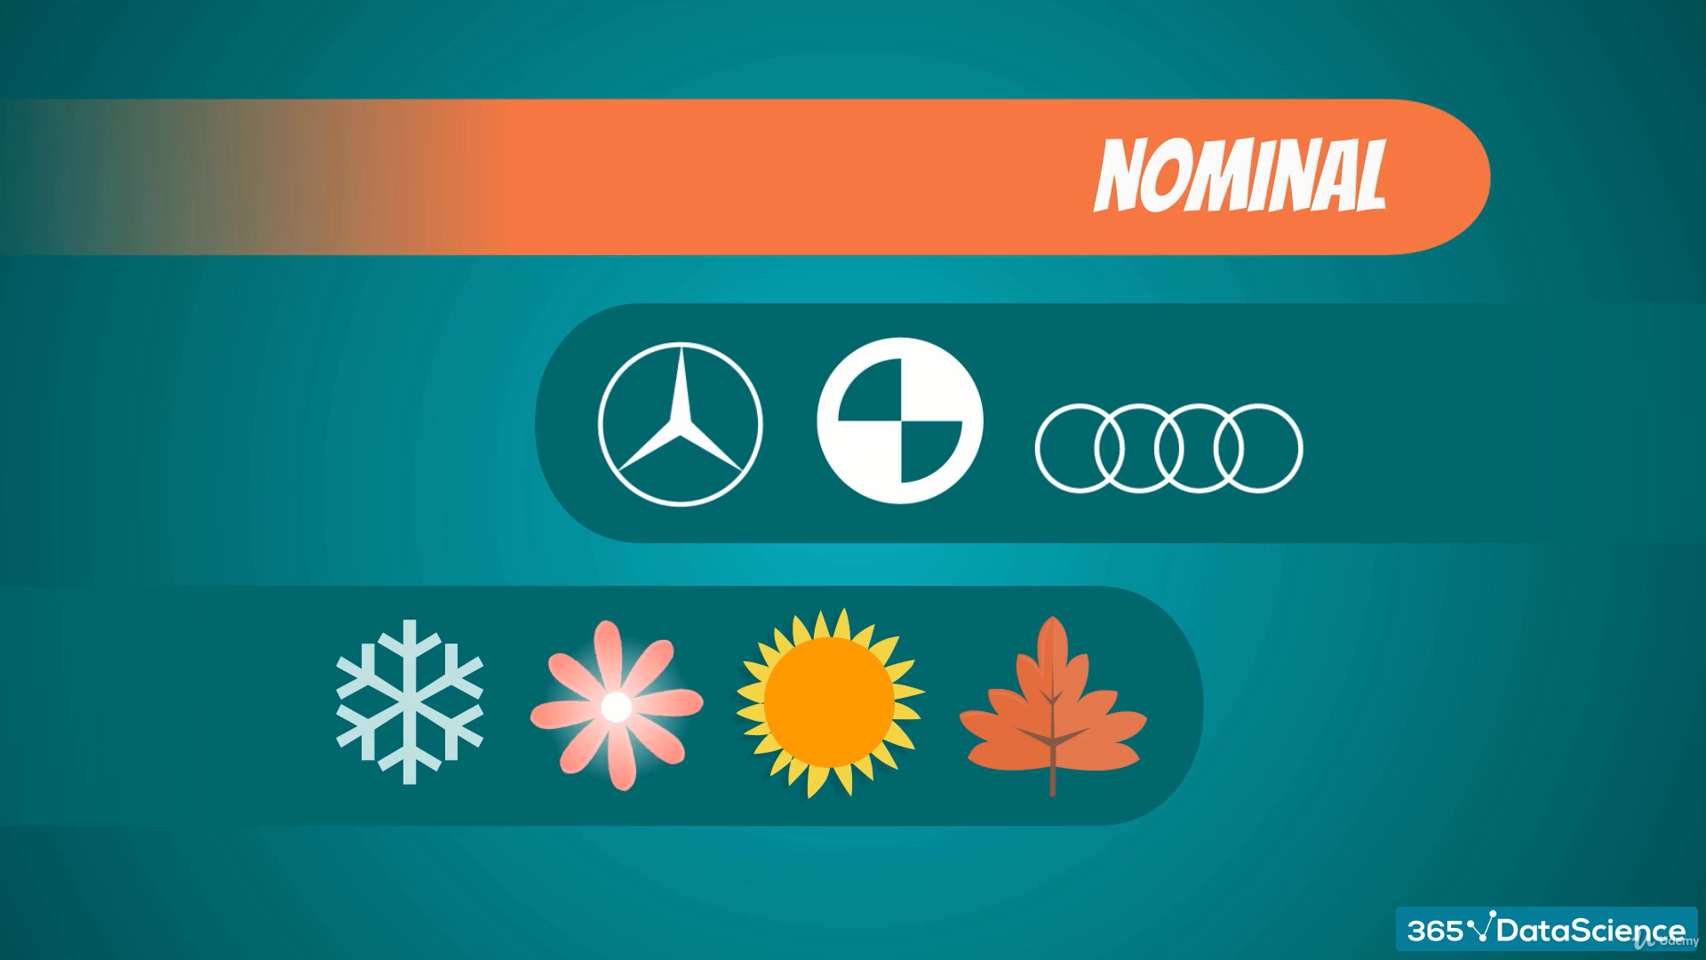
Mercedez
BMW
Audi
(CANNOT BE ORDERED)
Winter
Spring
Summer
Autumn

Slide 10
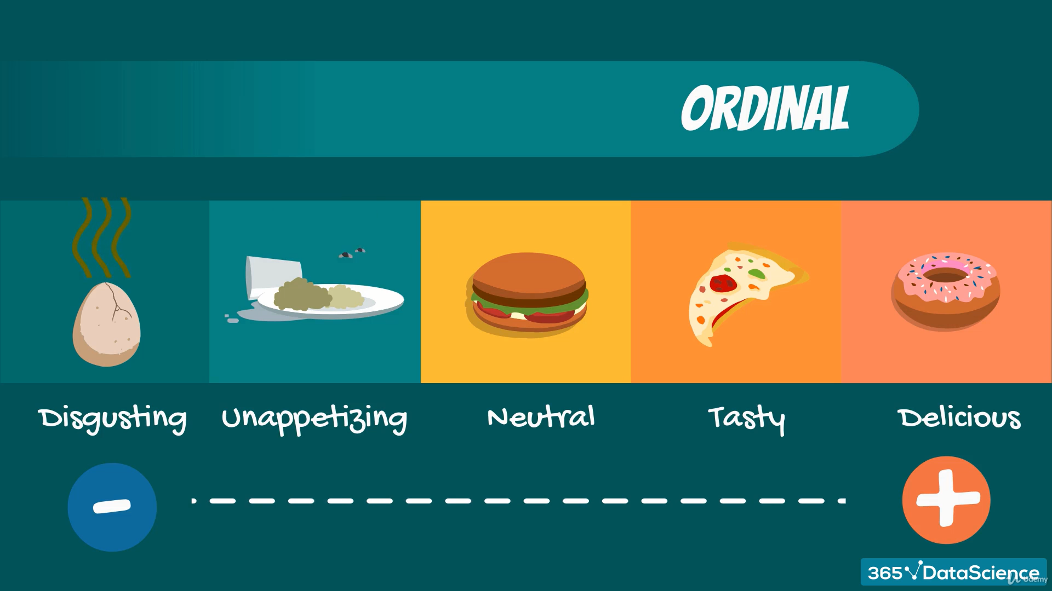
(HAS A SPECIFIED ORDER)

Slide 11
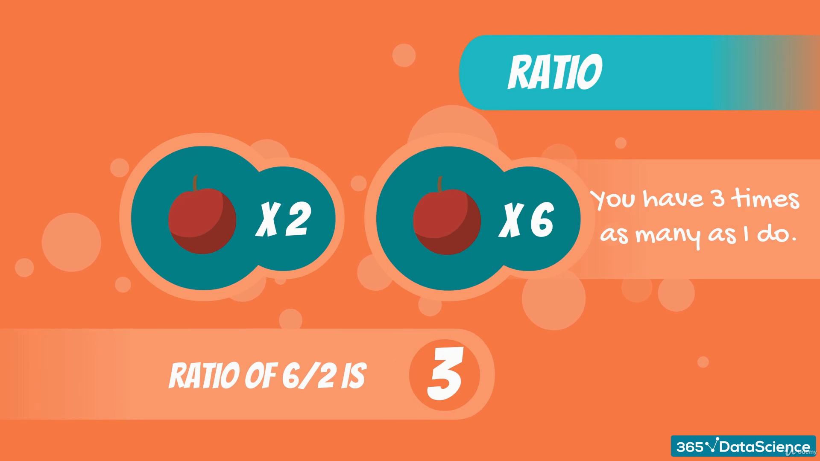
(Ratio has a true zero)

Slide 12
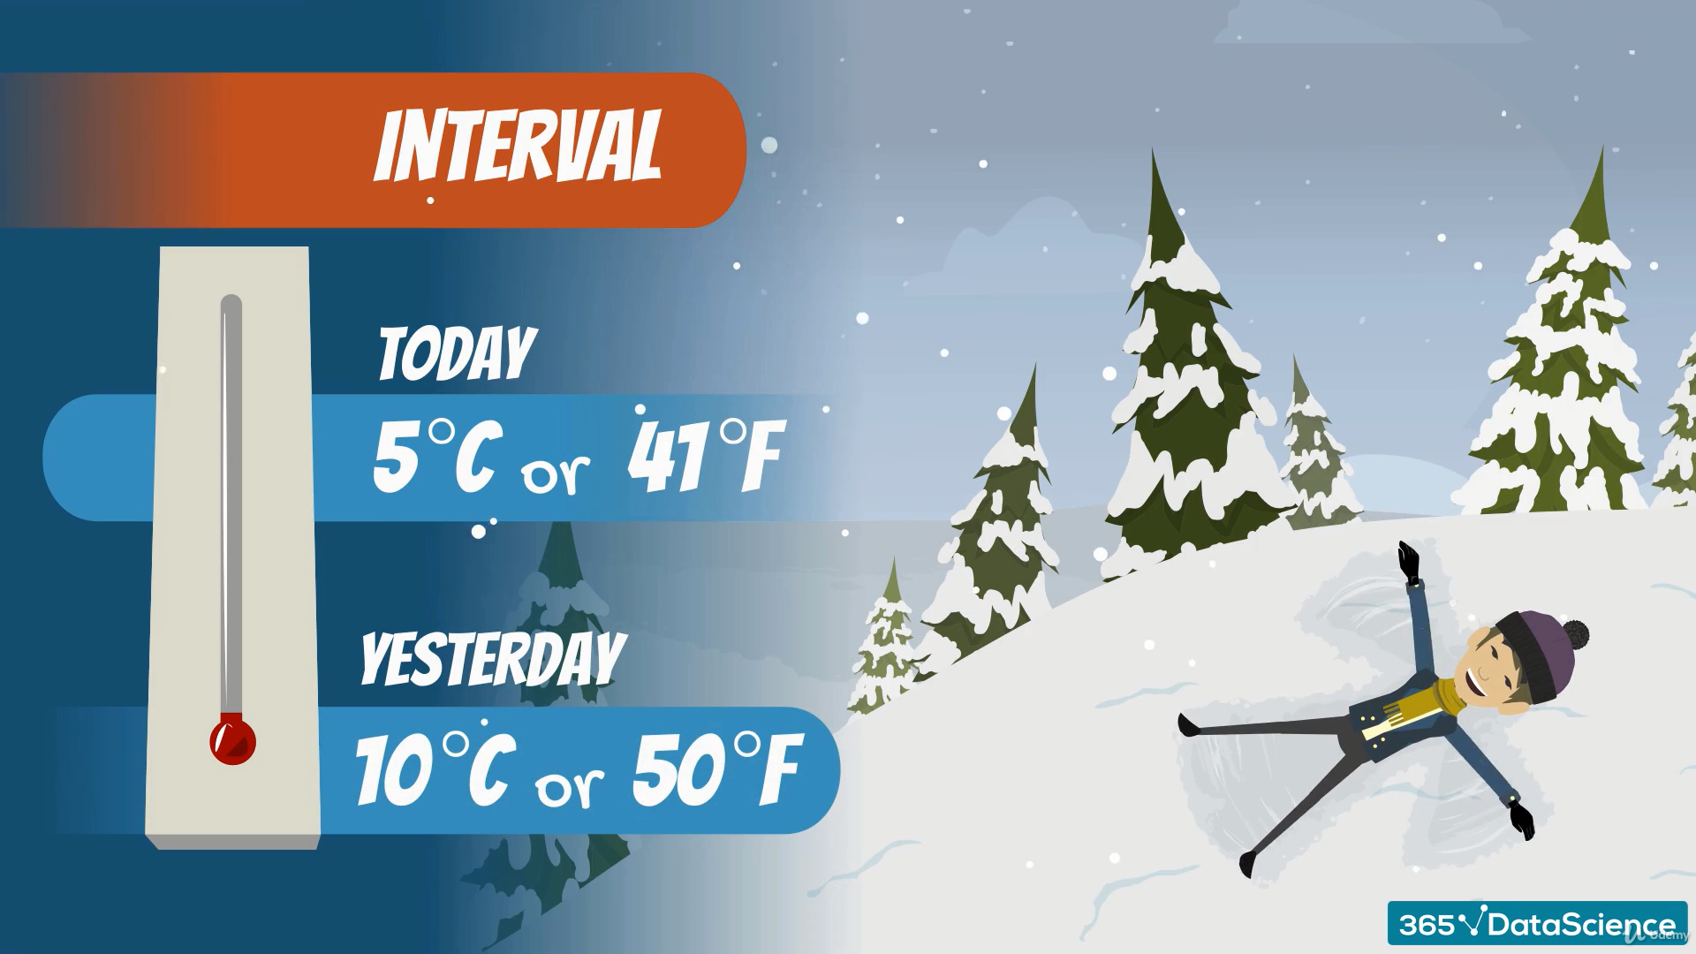
(Interval doesn’t have a true zero)

Slide 13
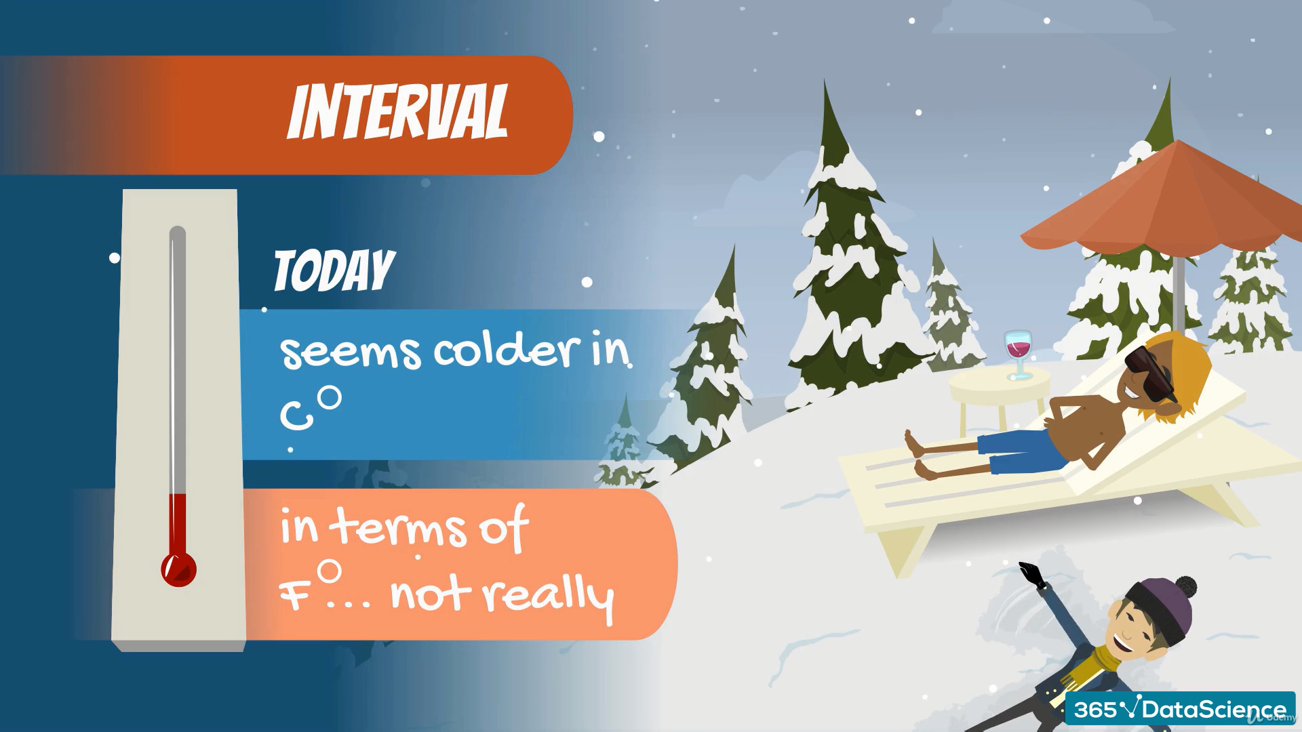

Slide 14
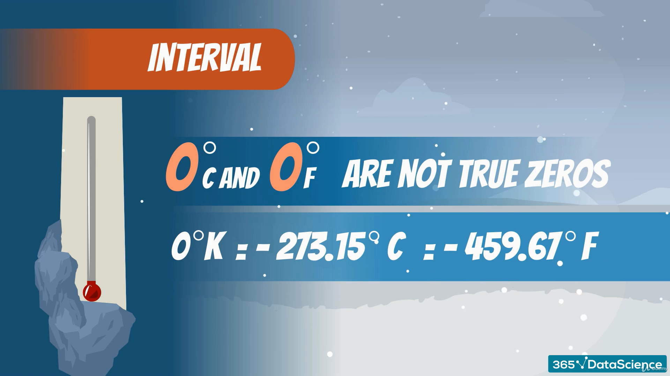

Slide 15
The Temperature Dilemma
0 degree Celsius and 0 degree Fahrenheit are not true zeroes
These scales were artificially created by humans for convenience
0 degree Kelvin is a true zero. That is the coldest anything can get.
Variables in Kelvin are Ratios while Variables in Celsius & Fahrenheit are Intervals.
All numbers like 1, 2, 3, 10, 12.42342, e, pi, etc. can be both Interval and Ratio.
Just be careful of the context you are operating in!!

Slide 16
III. Distributions

Slide 17
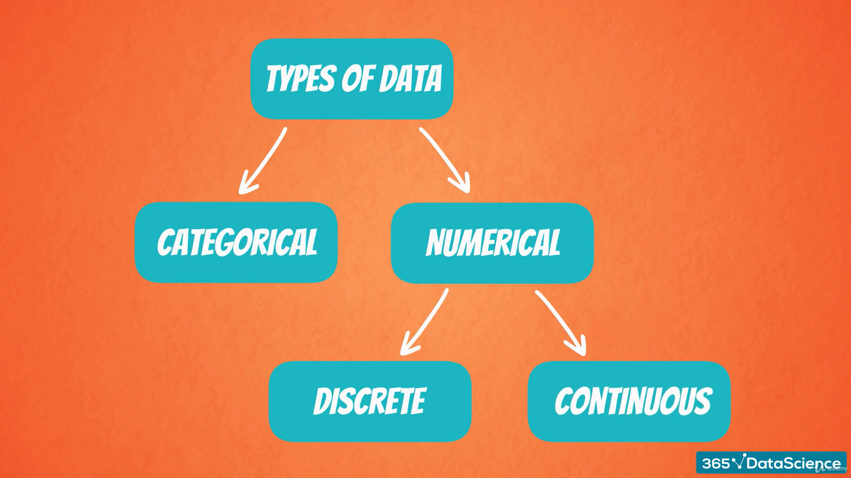

Slide 18
Thank you…

